Slide 1
Small software design

Slide 2
Design in class - Simple software Design
A BookStore Software
Book store software can have various features and functions depending on the needs and preferences of the users.
So there are common functions of Book management module:
First function allows Book Manager (users) to see the information of each book in their inventory, such as title, authors, type, publisher, year, etc. Users can also search for books by keywords or authors.
The second function allows users to enter the details of a new book into their inventory database. Users can also import data from excel sources to save time and avoid errors.
Next function of this module allows users to edit or update the details of an existing book in their inventory database.
The last function allows users to remove a book from their inventory database. Users can also delete multiple books at once or archive them for future reference.
Task [1]: .... 60 mins
• Analyse actors and use cases.
• Draw use case diagram
• Describe use case scenarios
• Draw Mockup/Wireframe
Task [2]: .... 60 mins
• List entity classes.
• Draw class diagram
• Draw Sequence diagram for main use case
• Describe main methods of classes (of class diagram)

Slide 3
Solution of Task #1

Slide 4
Actor & Use case
Actors:
• Book manager
Use case:
Feature: Book management (module)
• View books and detail of book.
• Add a new book
• Modify an existing book
• Delete a book

Slide 5
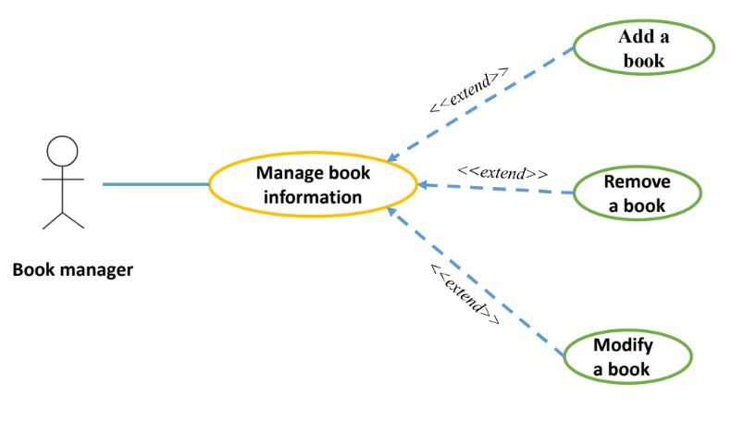
Use case diagram

Slide 6
Requirements
Use-case: Add a book
Stimulus: Book manager clicks “Add new” button
Main flow
1. System changes into the edit mode
2. Book manager add the detail
3. Book manager selects “Save” button
4. System saves the new detail
Use-case: Modify a book
Stimulus: Book manager clicks “Modify” button
Main flow
1. System changes into the edit mode
2. Book manager changes the detail
3. Book manager selects “Save” button
4. System saves the new detail
Use-case: Manage book information
Actor: Book manager
Stimulus: Book manager chooses “Manage book information” in the main menu
Main flow:
1. System opens the Manage Book window
2. System gets the list of books
3. System displays the list of books
4. Book manager chooses a book from the list
5. System gets the book detail and shows
Alternative Flow:
Search book after step 3.xxxx
Extended points: Modify a book, Add a book, Remove a book (At step 5)
Use-case: Remove a book
Stimulus: Book manager clicks “Remove” button
Main flow
1. System shows a dialog to confirm the removing
2. Book manager confirms
3. System remove the book

Slide 7
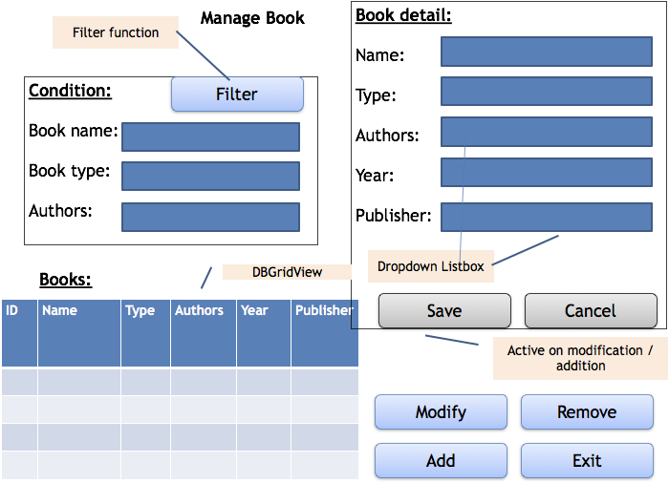

Slide 8
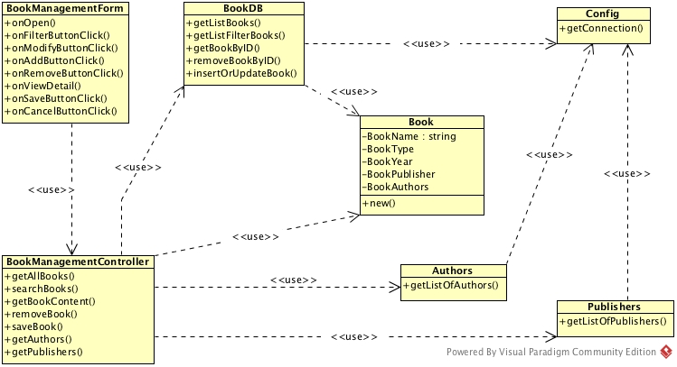

Slide 9
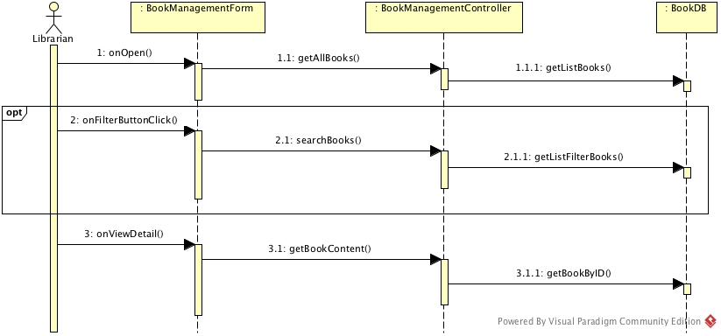
Sequence diagram for the main use-case

Slide 10
BookManagementForm
This is a C# form
onOpen
Fired when the form is opened
Algorithm:
Call BookManagementController.getAllBooks to return a result
set (DBGridView) listBook.dataSource = result
Disable all controls on Editing frame
onFilterButtonClick
Fired when user clicks on the Filter button
Algorithm:
Call BookManagementController.searchBook (bookName, bookType, bookAuthors) to return a DataSet result
If the DataSet is not empty then set (DBGridView) listBook.dataSource = result
Otherwise, set listBook.dataSource = null

Slide 11
BookManagementForm (cont.)
onViewDetail
Fired when user changes the selection on listBook (DBGridView)
Algorithm
Get the ID value of the selected row of listBook into bookID
Call BookManagementController.getBookContent (bookID)
Fill the TextBox controls on the form
onModifyButtonClick
Fired when user clicks on the Edit button
Algorithm:
If there is no data in the TextBox controls, exit
Get the list of authors by calling BookManagementController.getAuthors and populate the list box Authors on the form
Get the list of publishers by calling BookManagementController.getPublishers and populate the list box Piublishers on the form
Change the TextBox controls to enable them in editing
Enable the Save and Cancel buttons

Slide 12
BookManagementController
public static ResultSet getAllBooks ()
Algorithm:
return BookDB.getListBooks ()
public static ResultSet searchBooks (String bookName, String bookType, String bookAuthors)
Algorithm:
return BookDB.getListFilterBook (bookName, bookType, bookAuthors)
public static Book getBookContent (Long bookID)
Algorithm:
return BookDB.getBookByID (bookID)
public static boolean removeBook (Long bookID)
Algorithm:
return BookDB.removeBookByID (bookID)

Slide 13
BookDB
public static ResultSet getListBooks()
Algorithm:
open a Database Connection using Config.getConnection()
generate a SQL statement to select all records from the tbBook joined with tbAuthor and tbPublisher tables
execute a Statement on the SQL statement and return the result
public static ResultSet getListFilterBook (String bookName, string bookType, string bookAuthors)
Algorithm:
open a Database Connection using Config.getConnection()
generate a SQL statement to select records from the tbBook joined with tbAuthor and tbPublisher tables with the given conditions
execute a Statement on the SQL statement and return the result
public static Sach getBookByID(Long bookID)
Algorithm:
open a Database Connection using Config.getConnection()
generate a SQL statement to select a record from the tbSach joined with tbBook joined with tbAuthor and tbPublisher tables with the given bookID
execute a Statement on the SQL statement
return a new Book object with the data from the ResultSet if any or return NULL

